Slide 1
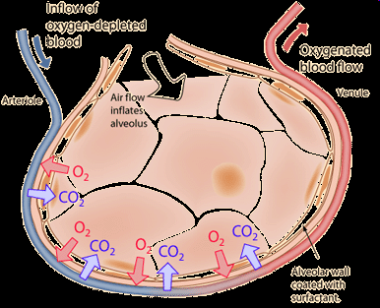
Gas exchange

Slide 2
Objective:
Understand how the body ensures efficient gas exchange

Slide 3
Gas exchange surfaces
Gas exchange happens in the alveoli in the lungs.
There are FOUR ways that alveoli increase the rate of gas exchange the alveoli:

Slide 4
Gas exchange surfaces
  1. Very thin walls (1 cell thick)
  Gas molecules do not have far to travel to move in or out of the blood.

Slide 5
    2. Have a large surface area
The size and design of alveoli creates a large surface area.
This increases the amount of gases that can be exchanged in a short time.
(If opened up and spread out an adults lungs can cover 1/3 of a tennis court)

Slide 6
  3. They are moist
Gases must be dissolved in a fluid before they can diffuse across a membrane.
This speeds up gas exchange.
(The lungs are deep in the body to prevent excessive evaporation of water. )

Slide 7
4. Have a large blood supply
The large number of blood vessels (capillaries) that surround each alveoli increase the amount of blood that is in close contact with the air in the alveolus sac.

Slide 8
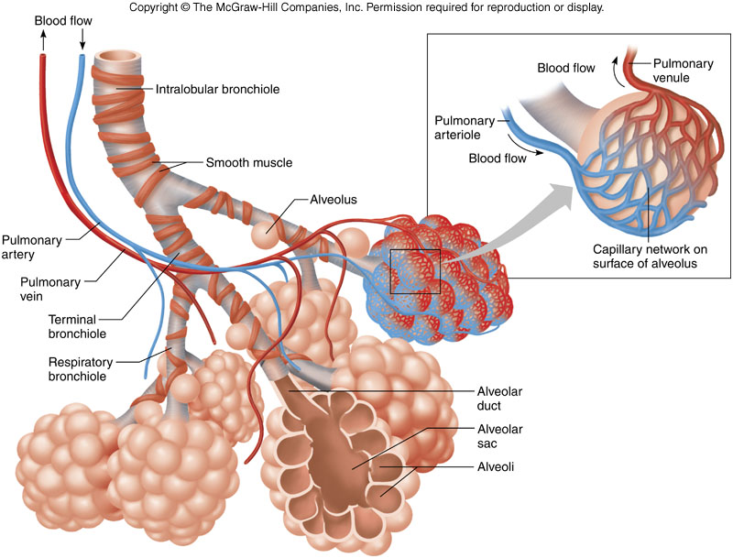


Slide 9
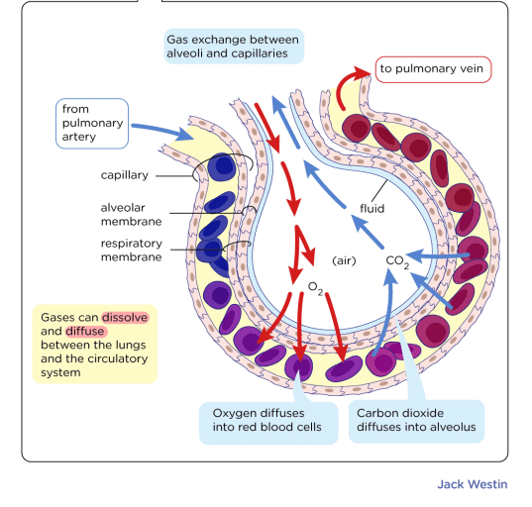

Slide 10
Breathing mechanisms
Understand that the mechanics of breathing help to maintain the efficient exchange of gases in the lungs.

Slide 11
Breathing
Breathing is the process of moving air into and out of the lungs.
The purpose of breathing is to exchanged oxygen and carbon dioxide between the lungs and the air.

Slide 12
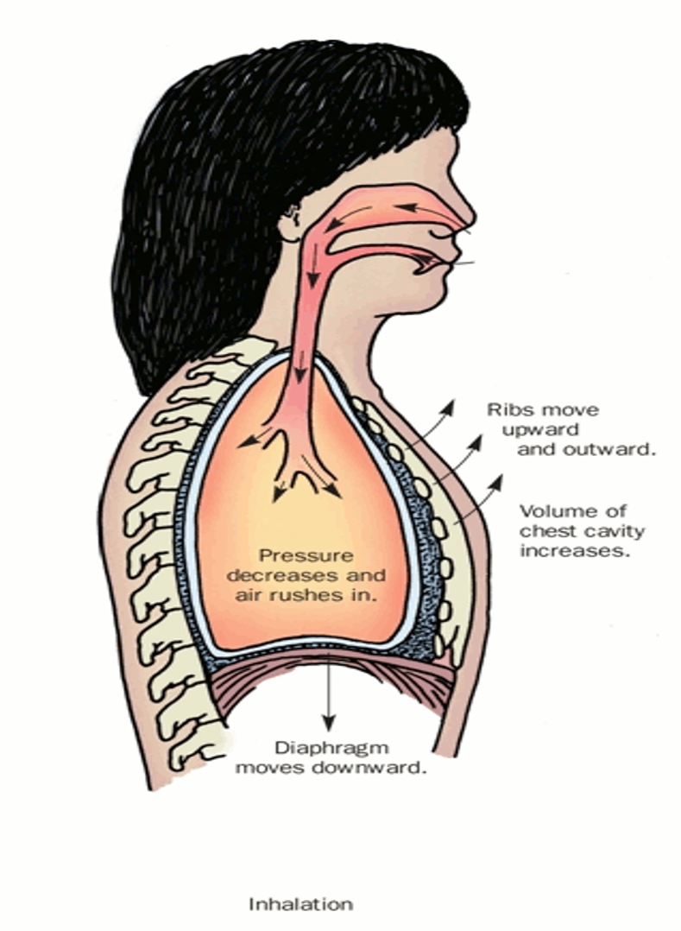
Breathing – Inhaling
Inspiration (inhalation)
Diaphragm contracts and flattens
Intercostal muscles contract to move ribs up and out
Pleura membrane around lungs moves with the chest cavity
This causes the internal space to increase and so the pressure to reduce
Air flows through the nose and trachea until pressure is equalized

Slide 13
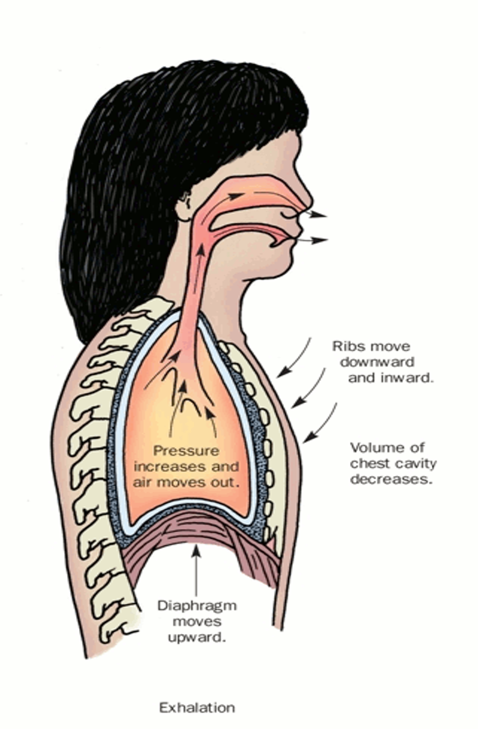
Breathing – Exhaling
Expiration (exhalation)
Diaphragm relaxes and rounds
Intercostal muscles relax to move ribs down and in.
Pleura membrane around lungs moves back in with the chest cavity
This causes the internal space to decrease and so the pressure to increase
Air flows out through the nose and trachea until pressure is equalized

Slide 14
